Slide 1
Lesson 7.6: Programmatic DB Communication
CSC430/530 – DATABASE MANAGEMENT SYSTEMS

Slide 2
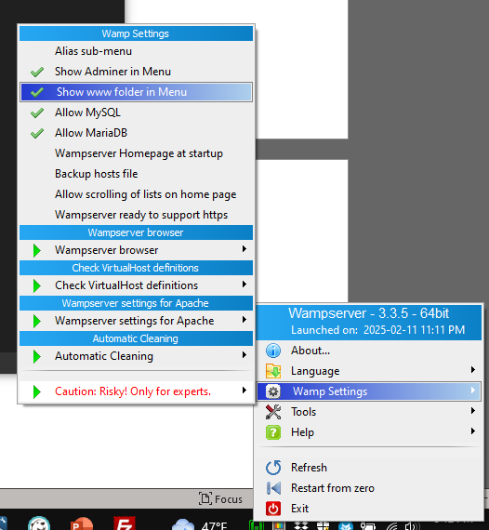
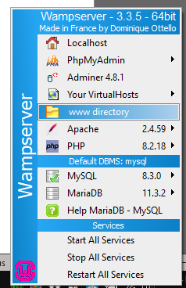

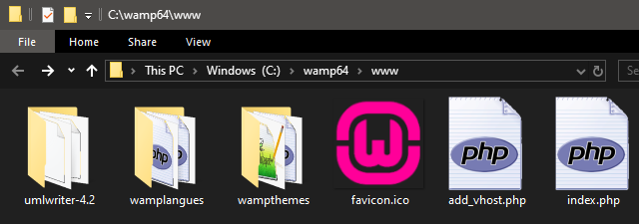
Setup in WAMP
Navigate to "localhost"
Left click
on WAMP
Right click
on WAMP
Create index.php

Slide 3
PHP Hello World
<?php
echo "Hello World <br />";
?>

Slide 4
PHP Basics
Code must be inside <?php ?> tags
"echo" used for printing
Variables start with $
Syntax similar to C
Is object oriented
Has hundreds of built in functions
Is dynamically typed

Slide 5
<?php
require('../master.php');
Master::putHeader(Page::$GRADE_VIEWER);
?>
<form action="index.php" method="post">
<?php
require_once('students.php');
require_once('../login.php');
require_once('../profile.php');
require_once('stats.php');
require_once('../encryption.php');
require_once('../gui.php');
function viewGrade() {
$profile = Login::getProfile();
if ($profile->auth != AuthType::STUDENT) {
echo "<h2>What are you doing here?<br />You are a Professor.<br />Impersonate a student to see their grades.</h2>";
return;
}
GUI::getCourseSelectorResult($profile);
GUI::writeCourseSelector($profile);
$coursefile = $profile->getActiveCourse()->toFilename();
$file = Master::$currentPage->rootPath . Files::GRADES . "{$coursefile}.data";
$xml = Encryption::decryptXmlFile($file);
if (!$xml) {
die("<h3>No Grades Yet</h3>");
}
$node = null;
Stats::load($xml);
for($i = 0; $i < count($xml->Student); $i++) {
$studName = $xml->Student[$i]['name'];
if ($xml->Student[$i]['email'] == $profile->shortEmail) {
$node = $xml->Student[$i];
break;
}
}
if ($node != null) {
$hash = md5($node->asXML());
$profile->setActiveCourseGradeHash($hash);
}
$student = new Student($studName, $profile->shortEmail);
for($i = 0; $i < count($node->gi); $i++) {
$item = $node->gi[$i];
$gradedItem = new GradedItem($item, $i);
$student->addGradedItem($gradedItem);
}
$student->display();
}
viewGrade();
echo "<div style='clear:both; margin-bottom:16em;' />";
?>
</form>
<?php
Master::putFooter();
?>

Slide 6
Talk to DB
Use mysqli library
<?php
// connection string settings
$server = 'localhost';
$user = 'username';
$pass = 'password';
$db = 'database_name';
// connect to database
$conn = new mysqli($server, $user, $pass, $db);
// check for errors
if ($conn->connect_error) {
die('connection error: ' . $conn->connect_error);
}
?>

Slide 7
Run Simple Queries
<?php
// construct and run query
$query = 'SELECT * FROM employee';
$result = $conn->query($query);
// error checking
if ($result->num_rows == 0) {
echo 'No results from query';
}
$sqlError = mysqli_error($conn);
if (strcmp($sqlError, '')) {
echo "Sql error: $sqlError";
}
// show results
while ($row = $result->fetch_assoc()) {
echo "{$row['fname']} {$row['lname']}<br />";
}
?>

Slide 8
Better Modularity
<?php
function select($attrs, $table) {
// construct and run query
$query = "SELECT $attrs FROM $table";
$result = $conn->query($query);
// error checking
if ($result->num_rows == 0) {
echo 'No results from query';
}
$sqlError = mysqli_error($conn);
if (strcmp($sqlError, '')) {
echo "Sql error: $sqlError";
}
// show results
return $result;
}
// main
$result = select('*', 'employee');
while ($row = $result->fetch_assoc()) {
echo "{$row['Fname']} {$row['Lname']}<br />";
}
?>

Slide 9
Using Triggers
/* SQL */
DELIMITER $$
CREATE TRIGGER bob_to_bobby
BEFORE INSERT ON employee
FOR EACH ROW
BEGIN
IF (NEW.fname = 'Bob') THEN
SET NEW.fname = 'Bobby';
END IF;
END $$
DELIMITER ;
// PHP
$query = "INSERT INTO employee VALUES ('bob', 'x', 'robert', 475869251, '2000-01-01', '123 main, ruston, la', 'm', 10, NULL, 1)";
$result = $conn->query($query);

Slide 10
Using Views
/* SQL */
CREATE VIEW dept_5_emps AS
SELECT *
FROM employee
WHERE dno = 5;
// PHP
$query = 'SELECT * FROM dept_5_emps';
$result = $conn->query($query);
while ($row = $result->fetch_assoc()) {
echo "{$row['fname']} {$row['lname']}<br />";
}

Slide 11
Using Stored Procedures
/* SQL */
DELIMITER $$
CREATE PROCEDURE give_raise_to_all_by_name_prefix(IN fname_part VARCHAR(10))
BEGIN
UPDATE employee
SET salary = salary * 1.1
WHERE fname LIKE concat(fname_part, '%');
END $$
DELIMITER ;
// PHP
$query = "CALL give_raise_to_all_by_name_prefix('a')";
$result = $conn->query($query);

Slide 12
Using Functions
/* SQL */
DELIMITER $$
CREATE FUNCTION highest_paid_emp_by_dept(dept_number INT)
RETURNS VARCHAR(50)
DETERMINISTIC
READS SQL DATA
BEGIN
DECLARE high_paid_emp varchar(50);
SELECT concat(fname, ' ', lname) INTO high_paid_emp
FROM employee
WHERE dno = dept_number AND
salary >= ALL ( SELECT salary FROM employee WHERE dno = dept_number );
RETURN high_paid_emp;
END $$
DELIMITER ;
// PHP
$query = 'SELECT highest_paid_emp_by_dept(5)';
$result = $conn->query($query);
echo 'Highest paid in dept 5 is ' . $result->fetch_array()[0];

Slide 13
Executing Multiple Queries
<?php
$query = 'SELECT * FROM employee; SELECT * FROM dependent;';
$conn->multi_query($query);
echo '<h2>Results: </h2>';
do {
if ($result = $conn->store_result()) {
while ($row = $result->fetch_row()) {
echo implode(',', $row) . '<br />';
}
}
if ($conn->more_results()) {
echo '<br />';
}
} while ($conn->next_result());
?>

Slide 14
Watch Out! SQL Injection
SQL injection is the process of getting a WHERE clause to succeed on row(s) that it wasn't meant to succeed on
This gives an unauthorized user access to information they should NOT have
It can even cause entire tables or databases to be dropped when they shouldn't have been!
It is extremely easy to do if the developer hasn't protected against it!

Slide 15
Watch Out! SQL Injection
<html> <head> </head> <body>
<?php
if (isset($_POST['fname'])) {
// connection string settings
$server = 'localhost';
$user = 'root';
$pass = '';
$db = 'company';
// connect to database
$conn = new mysqli($server, $user, $pass, $db);
// check for errors
if ($conn->connect_error) {
die("connection error: " . $conn->connect_error);
}
$fname = $_POST['fname'];
$lname = $_POST['lname'];
$ssn = $_POST['ssn'];
// PHP
$query = "SELECT fname, lname, salary FROM employee WHERE fname = '$fname' AND lname = '$lname' AND ssn = '$ssn'"; // this is problematic!
$conn->multi_query($query);
$result = $conn->store_result();
echo '<h2>Results: </h2>';
while ($row = $result->fetch_assoc()) {
echo "<u>Name:</u> <strong>{$row['fname']} {$row['lname']}</strong> &nbsp;&nbsp; <u>Salary:</u> <strong>{$row['salary']}</strong><br />";
}
}
else {
echo "<form action='index.php' method='post'>";
echo " <label for='fname'>First Name: </label><input type='text' id='fname' name='fname' /><br />";
echo " <label for='lname'>Last Name: </label><input type='text' id='lname' name='lname' /><br />";
echo " <label for='lname'>SSN: </label><input type='text' id='ssn' name='ssn' /><br />";
echo " <input type='submit' />";
echo "</form>";
}
?>
</body> </html>

Slide 16
Watch Out! SQL Injection
Demo
Even the docs warn against this!
https://www.php.net/manual/en/mysqli.multi-query.php

Slide 17
Ways to Protect Against SQL Injection
Never use multi_query() function
Although this doesn't prevent a single bad query from running
Sanitize input
Look for bad characters (like single/double quotes, two dashes, semi colons) and remove them before adding them to the query
PHP has some built in functions to help with this
Use mysqli prepared statements
Allows you to write your query with placeholders for the user information
You then give it the user information in a separate function call, along with the data types you expect for each piece of information
It double checks the datatypes, and encloses strings in quotes so they can't become part of the query itself
Do not login as root!
Login as a user with only the privileges that are necessary for the app to work
There are many more techniques
This is a pretty good reference:
https://websitebeaver.com/prepared-statements-in-php-mysqli-to-prevent-sql-injection

Slide 18

Ways to Protect Against SQL Injection

Slide 19
Good Practice
Have a separate DB class that handles all database interactions
Can connect in constructor and save the connection as a field
Can have methods for all database interactions / queries
Use require_once to include this script in multiple pages
require_once('db.php');

Slide 20
Good Practice
class DB {
// fields
private static $server = 'localhost';
private static $user = 'user';
private static $pass = 'pass';
private static $db = 'database';
private $conn = null;
// constructor
function __construct() {
$this->conn = new mysqli(DB::$server, DB::$user, DB::$pass, DB::$db);
if ($this->conn->connect_error) {
die("connection error: " . $this->conn->connect_error);
}
}
function select($attrs, $table) {
// construct and run query
$query = "SELECT $attrs FROM $table";
$result = $this->conn->query($query);
// error checking
if ($result->num_rows == 0) {
echo 'No results from query';
}
$sqlError = mysqli_error($conn);
if (strcmp($sqlError, '')) {
echo "Sql error: $sqlError";
}
// show results
return $result;
}
}

Slide 21

Other Languages – Ruby (on rails)
Prerequisites:
Ruby on Rails installed
MySQL server running locally
Install:
Install the mysql2 gem
bundle add mysql2
Configure file config/database.yml
default: &default
adapter: mysql2
encoding: utf8mb4
pool: 5
username: root
password: pass
host: localhost
port: 3306
development:
<<: *default
database: company
Create an Employee model
rails generate model Employee
Run the query in a controller or Rails console
employees = Employee.all
employees.each {
|emp| puts emp.inspect
}

Slide 22

Other Languages – Node.js
Prerequisites:
Node.js installed
MySQL server running locally
Install:
Install the mysql2 package
npm install mysql2
Create a connection and execute the query
const mysql = require('mysql2/promise');
async function queryEmployees() {
const connection = await mysql.createConnection({
host: 'localhost',
user: 'root',
password: 'pass',
database: 'company',
port: 3306
});
const [rows] = await connection.execute(
'SELECT * FROM employee');
console.log(rows);
await connection.end();
}
queryEmployees();

Slide 23

Other Languages – Blazor
Prerequisites:
NET SDK installed
MySQL server running locally
Pomelo.EntityFrameworkCore.MySql (NuGet package)
Configure the database context in Program.cs:
string connStr = "server=localhost;port=3306;user=root;password=pass;database=company";
builder.Services.AddDbContext<CompanyContext>(
options => options.UseMySql(connStr,
ServerVersion.AutoDetect(connStr)
)
);

Slide 24
Other Languages – Blazor
Define the Employee model and CompanyContext
public class Employee {
public int Id { get; set; }
public string Name { get; set; }
}
public class CompanyContext : DbContext {
public DbSet<Employee> Employees { get; set; }
}
Run the query in a Razor component or service
@inject CompanyContext _context
@code {
private List<Employee> employees = new();
protected override async Task OnInitializedAsync() {
employees = await _context.Employees.ToListAsync();
}
}

Slide 25

Other Languages – ASP.Net
Prerequisites:
NET SDK installed
MySQL server running locally
Pomelo.EntityFrameworkCore.MySql (NuGet package)
Configure the connection in appsettings.json:
{ "ConnectionStrings": {
"CompanyDB": "server=localhost;port=3306;user=root;password=pass;database=company"
}
}
Define the Employee model and CompanyContext
public class Employee {
public int Id { get; set; }
public string Name { get; set; }
}
public class CompanyContext : DbContext {
public CompanyContext(DbContextOptions<CompanyContext> options) : base(options) { }
public DbSet<Employee> Employees { get; set; }
}

Slide 26
Other Languages – ASP.Net
Run the query in a controller
[ApiController]
[Route("[controller]")]
public class EmployeeController : ControllerBase {
private readonly CompanyContext _context;
public EmployeeController(CompanyContext context) {
_context = context;
}
[HttpGet]
public IEnumerable<Employee> Get() {
return _context.Employees.ToList();
}
}

Slide 27

Other Languages – Python (with Flask)
Prerequisites:
Python installed
MySQL server running locally
Install packages:
pip install Flask mysql-connector-python
Create a Flask app
from flask import Flask
import mysql.connector
app = Flask(__name__)
@app.route('/employees')
def get_employees():
connection = mysql.connector.connect(host='localhost', user='root', password='pass',
database='company', port=3306)
cursor = connection.cursor(dictionary=True)
cursor.execute('SELECT * FROM employee')
employees = cursor.fetchall()
cursor.close()
connection.close()
return {'employees': employees}
app.run()

